Slide 1
Handling HTTP Requests and Responses

Slide 2

Reading HTTP Headers
Setting HTTP Response Setting HTTP Status Code

Slide 3

Reading HTTP Headers

Slide 4
getHeader(String name)
getHeaderNames()
HTTP Request Header Methods
getAuthType()
getRemoteUser()
getRemoteAddr()
getContentLength()
getContentType()
getDate Header(String name)
getIntHeader(String name)

Slide 5

Reading HTTP Headers
Assisted Practice

Slide 6

Setting HTTP Response Headers

Slide 7
setHeader(String name,String value)
setIntHeader(Strng name,int value)
setDateHeader(String name,long date) containsHeader(String name) setContentLegth(int len) setLocale(Locale loc)
HTTP Response
Headers Method

Slide 8
Setting HTTP Response Headers
Assisted Practice

Slide 9

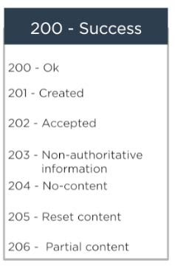
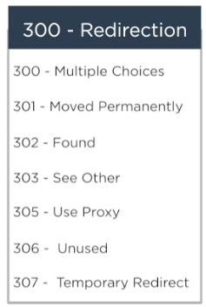
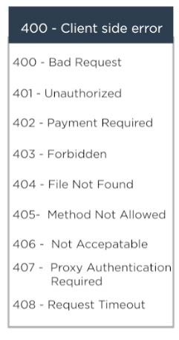
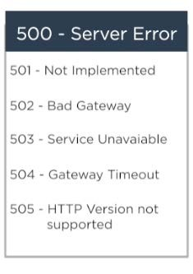
Setting HTTP Status Code

Slide 10
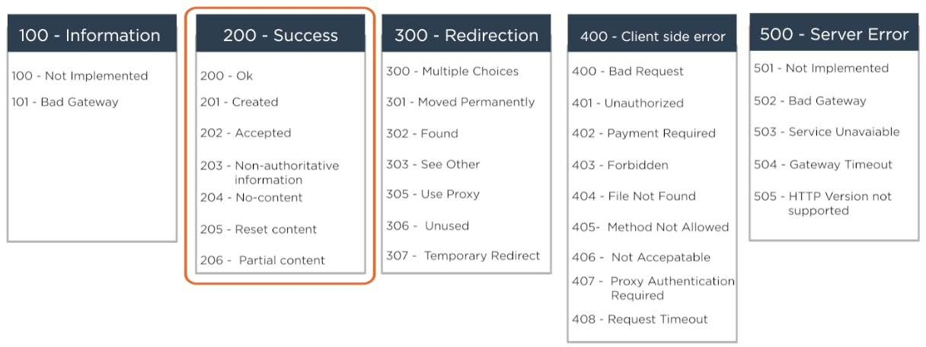
Setting HTTP Status Code

Slide 11
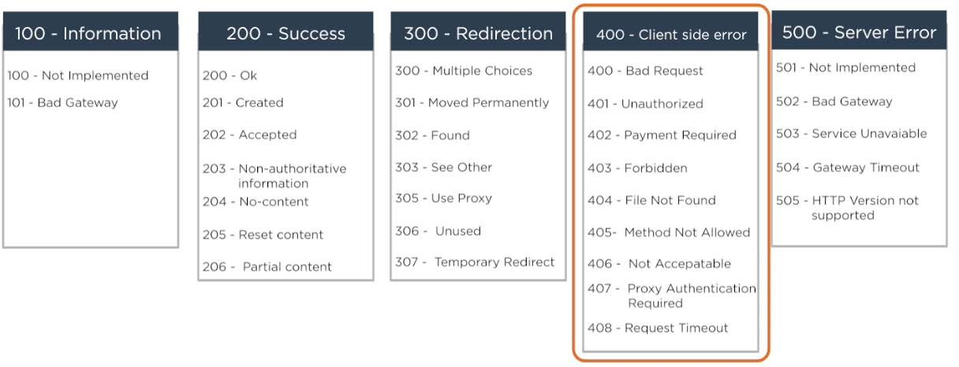
Setting HTTP Status Code

Slide 12
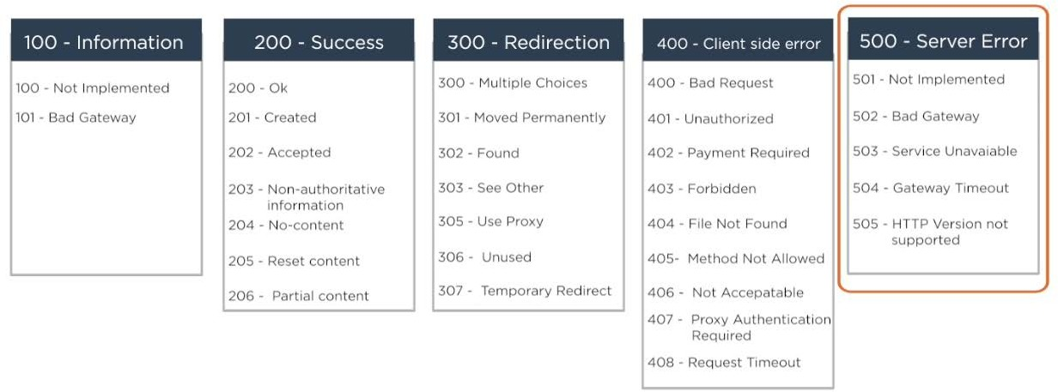
Setting HTTP Status Code

Slide 13
setStatus(int sc)
Methods to Set
sendError(int sc,String errmsg)
sendRedirect(String url)
HTTP Status Code

Slide 14

Setting HTTP Status Code

Slide 15

HTTP Request Headers
HTTP Response Headers HTTP Status Code

